Slide 1
LLOYDS BANK DIGDATA CHALLENGE
Anju Paul

Slide 2
Problem:
Lloyds Banking Group is launching a new loans product. Prior to the launch they would like you to use historical customer data to design a process which predicts the likelihood of a new customer not paying back their loan

Slide 3
Data:
Lloyds Banking Group has provided a dataset of 18,324 customers who:
Previously held a loan
The status of that loan: did the customer pay back the loan or not:
Customers who paid back are categorized as 'Fully Paid'
Customers who did not pay back their loan are categorized as 'Charged off'
Other credit and product information that can be used to understand a customer's credit or financial behavior

Slide 4
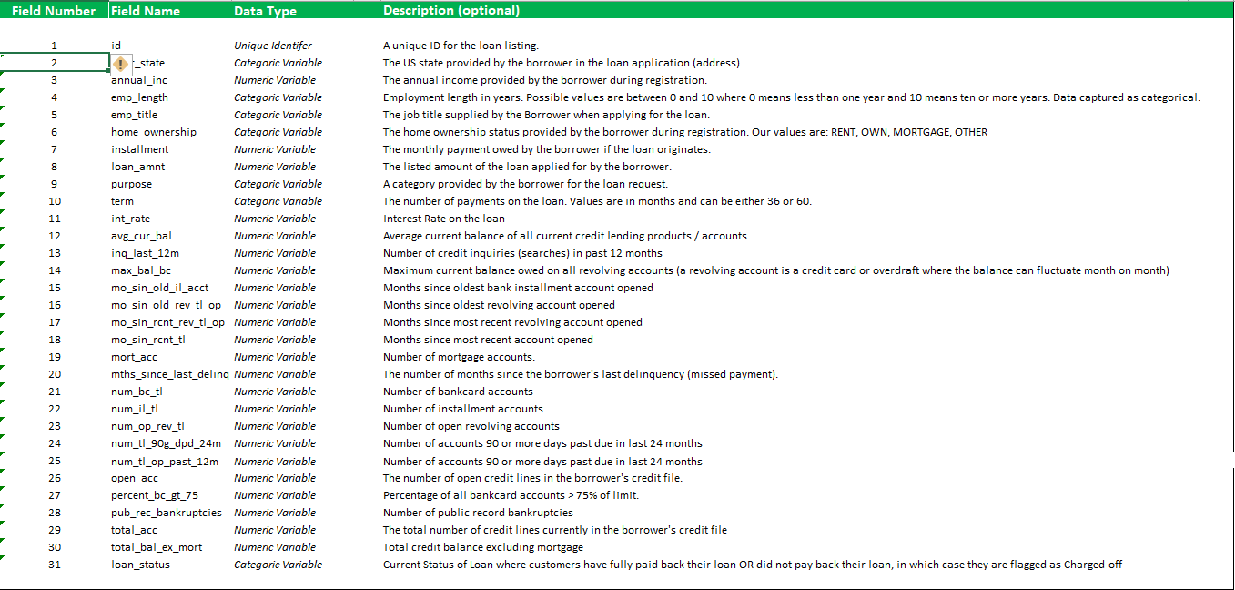
META Data:

Slide 5
Approach:
From the analysis of the problem, it is evident that the issue is a
Classification Problem
Supervised Learning

Slide 6
Process

Slide 7
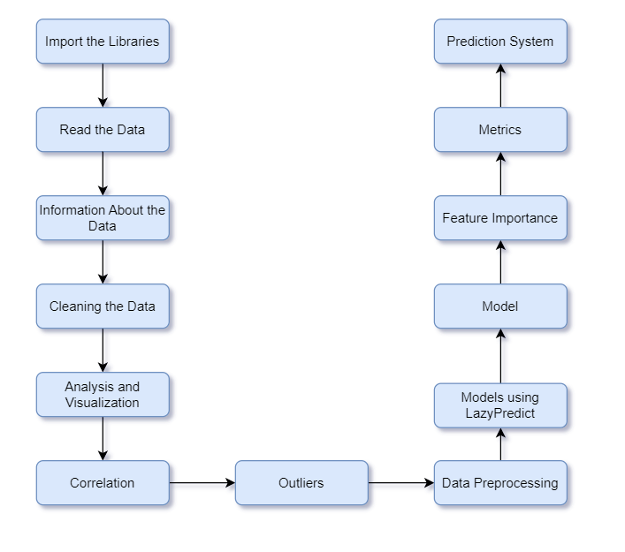
Process:

Slide 8
Stage 1:
Import the Libraries
Read the Data
Information about the Data
Statistical Details of the Data
Missing Data/Null Values
Duplicates

Slide 9
Stage 2:
Cleaning of Data
Dropping unwanted columns
Encoding categorical variables into numerical variables

Slide 10
Stage 3:
Analysis and Visualization
Correlation
Outliers

Slide 11
Stage 4:
Data Preprocessing
Models using LazyPredict

Slide 12
Stage 5:
Model
Feature Importance
Metrics
Accuracy
Confusion Matrix
Classification Report
ROC-AUC
Precision-Recall Curve
Prediction System

Slide 13
The STORY

Slide 14
Details
Data : 18324 entries and 31 variables
Null Values:
Replacement with mean
Replacement with zero
Replacement with the minimum value
Replacement with values from other columns
Drop
Duplicates: No Duplicate
Cleaning :
Dropping unwanted columns
Encoding categorical variable to numerical variable
Replace
LabelEncoder
One Hot Encoder

Slide 15
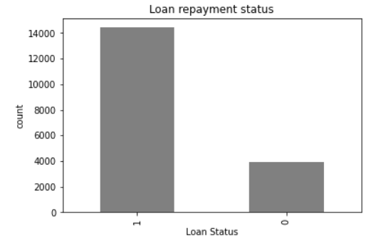
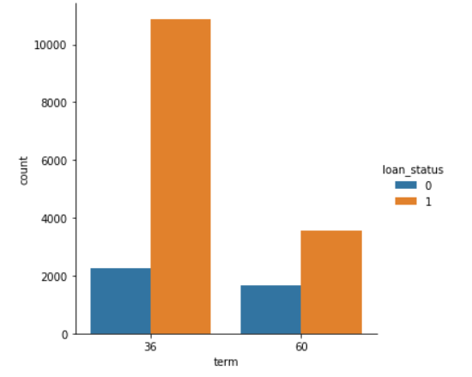
Analysis & Visualization
The number of charged-off cases is very less when compared to the paid ones.
The rate of "charged-off" loan repayment is more with long-term loans. The percentage in 5 years is almost double that of 3 years.

Slide 16
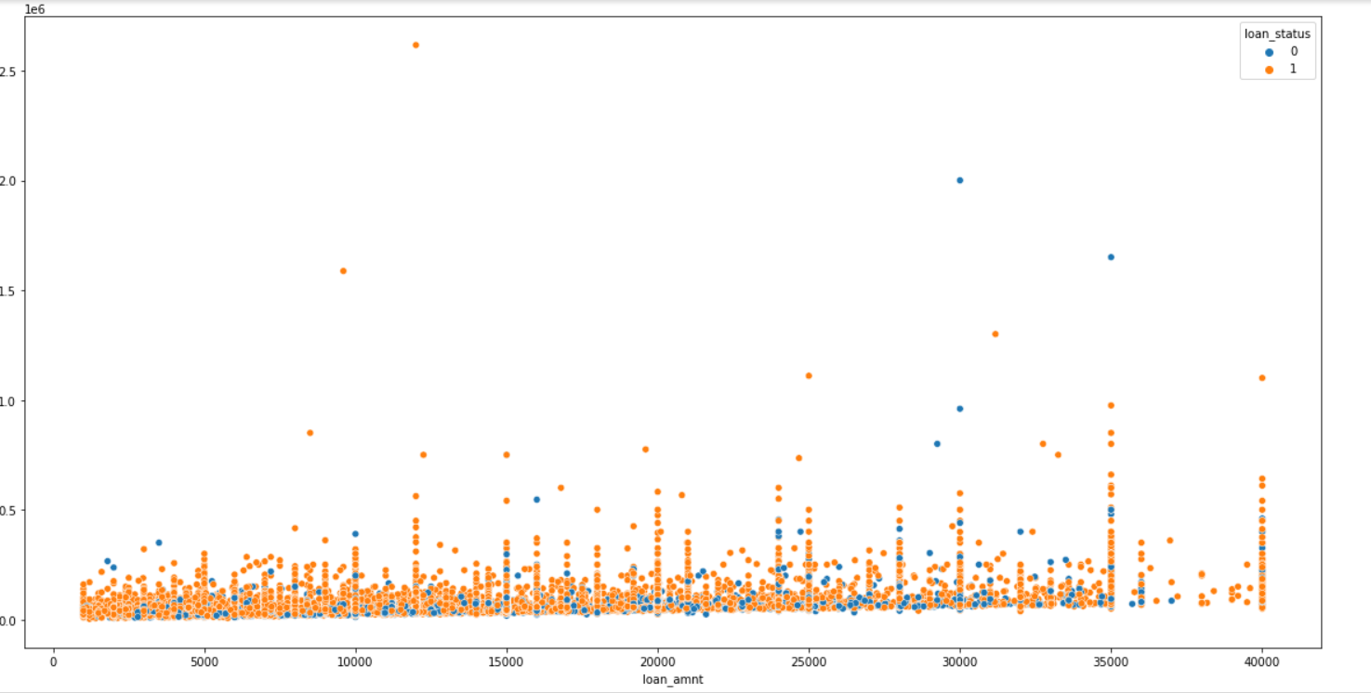
Contd..
more cases of loan non-repayment occur for a loan amount of 20000 to 35000 for an income less than 250000. The higher the annual income less are the chances of the loan being charged off.

Slide 17
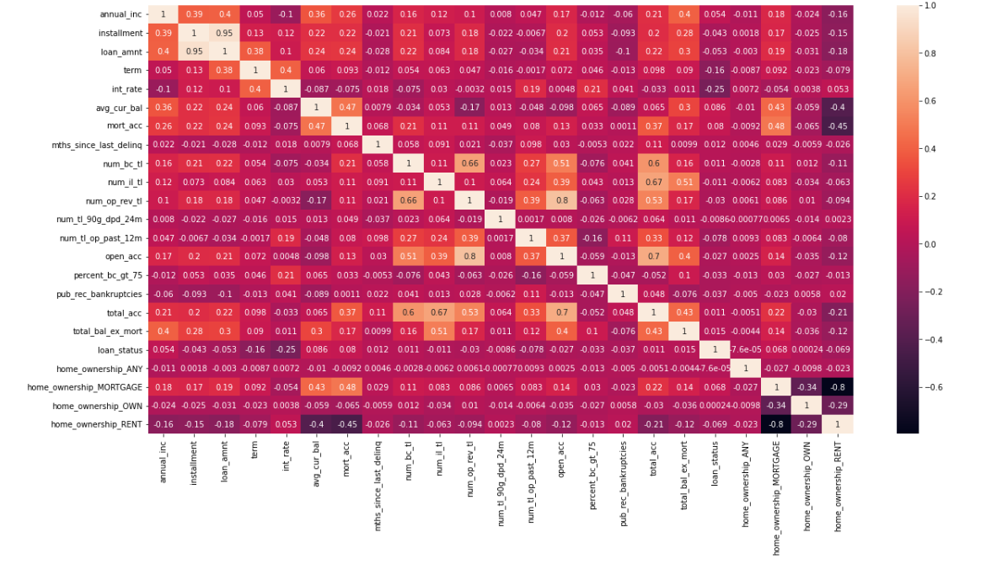
Contd..
There is not much of a correlation between the output and input variables. However, there is some inter-correlation between the variables themselves.
Outliers: KEEP all of them

Slide 18
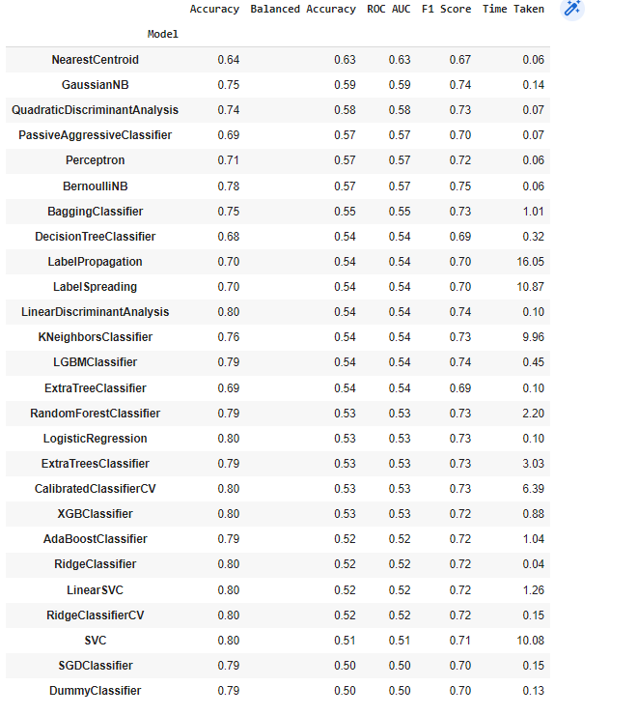
Contd..
Logistic Regression is selected

Slide 19
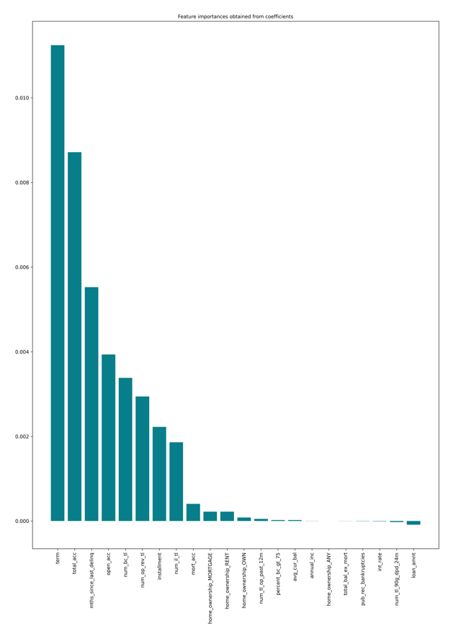
Feature Importance
Positive Impact : term, total_acc, mths_since_last_delinq, open_acc etc
Negative Impact: loan_amount, int_rate etc (the amount of the loan increases the repayment possibility decreases)
Zero Impact : annual_inc, home_ownership_any etc – could be removed.

Slide 20
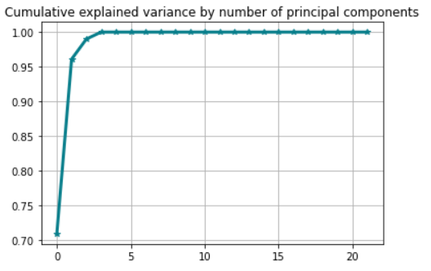
CONTD..
The PCA application shows that the first 4 principal components shared almost 100% of the variance.

Slide 21
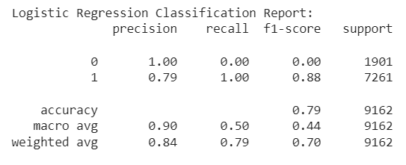
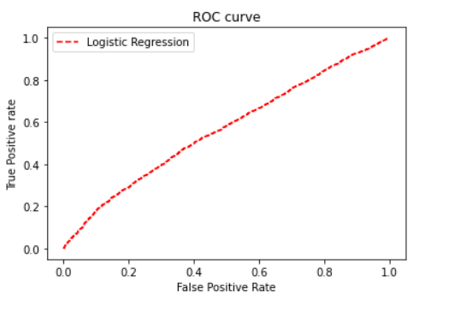
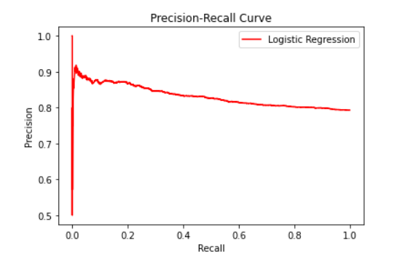
METRICS:
Accuracy: 0.7926216983191443
F1 score:0.7010382535587134

Slide 22
Questions??

